Slide 1
Financial Planning and Forecasting
Strategic Planning;
Operating Plan and Financial Plan;
Sales Forecast;
Additional Fund Needed Equation;
Forecasted Financial Statements;
Using Regression to Improve Forecasts;
Analyzing the Effects of Changes in Ratios

Slide 2
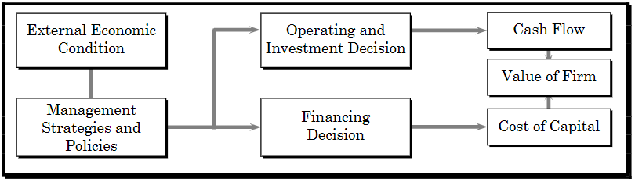
Strategic Planning
Strategic planning involves the strategies which are action oriented programs in order to give the organization a unified direction toward achieving the company mission, objectives and goals
Also known as corporate level planning
Basic four elements of strategic plans are:
Corporate Purpose
Corporate Scope
Corporate Objectives
Corporate Strategies
Strategic Plans and Shareholders Wealth

Slide 3
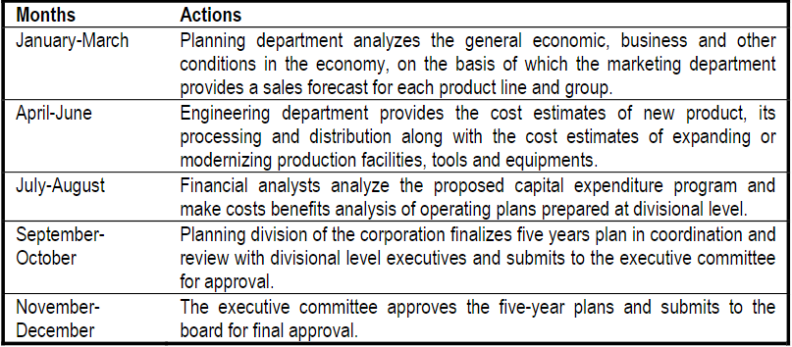
Operating Plan
Operating plan is concentrated in the best use of available resources
Can be formulated for any time horizon but 5 year plan is most common in practice
Formulated at department level to facilitate corporate plans
Also called unit plan

Slide 4
Financial Plan
Deals with the futurity of present decision in terms of setting goals, developing strategies to achieve them, translating strategies into detailed operational programs and assuring that plan are carried out
Indicates a firm’s growth, performance, investment and requirements of funds during the plan period
Basic element are projected income statement and balance sheet
Financial Plan enable:
Identify actions to be taken related to finance function
Develop alternatives
Investment and financial decision interaction
Relationship between present and future financial decision
Ensure financially viable strategic plan
Provide standard for comparison

Slide 5
Sales Forecast
Forecast of a firm’s volume and rupee sales for some future period generally based on recent sales trends plus forecast of economic prospects for the nation, region, industry and so forth.
To forecast sales growth, firm must rely on competitive market condition, customers taste and preferences, change in technology and future possibilities of market expansion
Firm must be careful enough to balance benefits of the growth in sales and cost to be incurred to achieve such growth
Methods of sales Forecast
Sales Persons
Customer Survey
Time Series Model
Econometric Model

Slide 6
Financial Forecasting
Involves systematic projection of expected actions of management in the form of financial statements, budgets etc.
Sort of working plan formulated for a specified period by arranging future activities
Efficient Forecasting includes:
Set up projected income statement and balance sheet
Determine need of financing
Forecasting appropriate sources
Control effective allocation of funds
We use additional funds needed (AFN) equation to provide financial forecast
AFN is based on two assumption:
All items of B/S except some liabilities are assumed proportionately related to sales volume
Most current B/S items are justifiable in size for the current sales volume

Slide 7
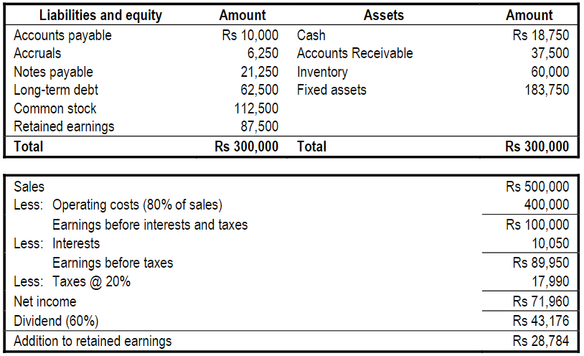
AFN and steps with example

Slide 8
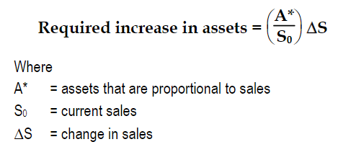

AFN and steps with example
Step 1: Determine required increase in assets
= capital intensive ratio
If sales is expected to increase by 30%, how much increase in assets is expected in the coming year ?

Slide 9
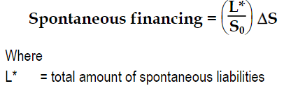
AFN and steps with example
Step 2: Determine the spontaneous amount of financing
Spontaneous increase in account payable, accrued wages and accrued taxes satisfy a part of financing need for required increase in assets
Spontaneous = increase spontaneously and proportionately with sales
How much is the spontaneous fund generated with increase in sales in the given balance sheet ?

Slide 10
AFN and steps with example
Step 3: Determine the addition to retained earnings
Retained earning of firm grow with increase in net income as a result of increase in sales, assuming PMR and DPR constant
M= Profit margin, RR= Retention Ratio, S₁ = forecasted sales = (S₀ + ∆S)
How much is additional to retained earning based on above example?

Slide 11



AFN and steps with example
Step 4: Determine the additional funds needed
Net external financing to be raised
Can be simplified as:
How much is the additional fund required on the example ?
Percentage of external funds required (PEFR) can be calculated by using formula

Slide 12
Forecasted Financial Statements
Constant profit margin, dividend payment assumption of AFN is not valid on reality as due to changing economic condition and firm’s financial policy inputs will be changed.
Project change in financial position and financial performance of a firm over a period of years
Forecasted income statement : incorporate changes in operating costs and other in response to sales to determine addition to retained earning
Forecasted balance sheet: to determine additional fund needed

Slide 13
Projected Income Statement
To have a fair and reasonable estimate of expected revenue, cost, profits, taxes, dividends and others
Is built around the estimate of expected sales for the forecasted period
Assumptions:
Variable cost changes proportionately as per change in sales
Change in sales results proportionate change in fixed cost if firm operating on full capacity else fixed cost remain constant till operating below full capacity
Additional borrowed amount will increase interest expenses
Increase in sales will cause increase in income

Slide 14
Example Problem
At the end of last year, Jagadamba Inc reported the following income statement:
This year company is forecasting a 25% increase in sales
Forecasted income statement assuming that the company is operating at full capacity
Forecasted income statement assuming that the company has sufficient idle capacity
Particulars | Amount
Sales | 800,000
Less: Operating cost excluding depreciation | 480,000
Gross Profit | 320,000
Less: Fixed operating expenses (Depreciation) | 100,000
EBIT | 220,000
Less: Interest | 20,000
EBT | 200,000
Less: Taxes (40%) | 80,000
Net Income | 120,000
Less: Dividends (50%) | 60,000
Addition to retained earning | 60,000

Slide 15
Projected Balance Sheet
Also called forecasted or pro-forma balance sheet
Is based upon the information in the projected income statement as well as supporting schedules and budgets
Steps:
Isolated balance sheet items which have direct relationship with sales
Express isolated items as a percentage of sales
Obtained projected values
Project balance in retained earnings account using equation
Projected R/E = Initial R/E + (Projected sales × Net Profit Margin × Retention Ratio)
Show the values of other B/S items
Determine the external funds requirement as the balancing item

Slide 16
Example Problem
Given the following data of Birat Limited as of December 2017
Sales = Rs 750 , Profit Margin = 5%, DPR = 60%, Tax rate = 50%
Balance sheet as of December 2017
Birat expected its sales to increase by 20% to Rs 900 in next year. The ratio of assets to sales and spontaneous current liabilities to sales would remain unchanged. Likewise the profit margin ratio, the tax rate and the dividend payout would remained unchanged.
Required: Projected balance sheet for 2018
Equity and Liabilities | Amount | Assets | Amount
Share Capital | 100 | Fixed Assets | 250
Retained Earning | 100 | Inventories | 150
Debentures | 100 | Receivable | 150
Short term Bank Loan | 150 | Cash | 30
Account Payable | 100 | Others | 20
Accrued Expenses | 50
Total | 600 | Total | 600

Slide 17
Raising Additional Fund Needed
After determining external fund requirement, company has to choose the source of finance.
If Birat has used following capital structure:
Notes payable = 15% × 68 = 10.20
Long term debt = 40% × 68 = 27.20
Common stock = 45% × 68 = 30.60
Then construct new balance sheet.

Slide 18
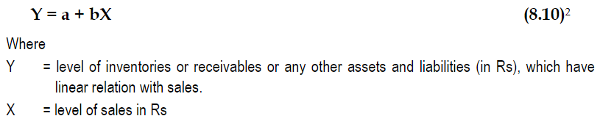
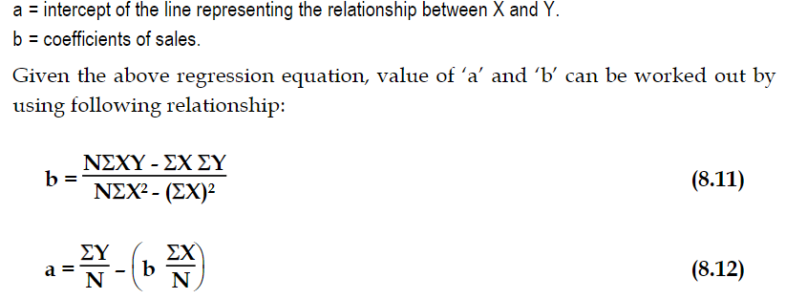
Using Regression to Improve Forecasts
Assume linear relationship between certain certain type of assets and level of sales
Regression equation can be expressed as:

Slide 19
Example Problem
The following data were collected from New Hira Company
Required:
State the equation that explains the relationship between sales and inventory
Forecast the inventory level for 2017, if the expected sales will be Rs, 135,000
Year | Sales ‘000 | Inventor ‘000
2011 | 110 | 2,440
2012 | 105 | 2,260
2013 | 120 | 2,680
2014 | 140 | 2,920
2015 | 115 | 2,500
2016 | 120 | 2,560

Slide 20
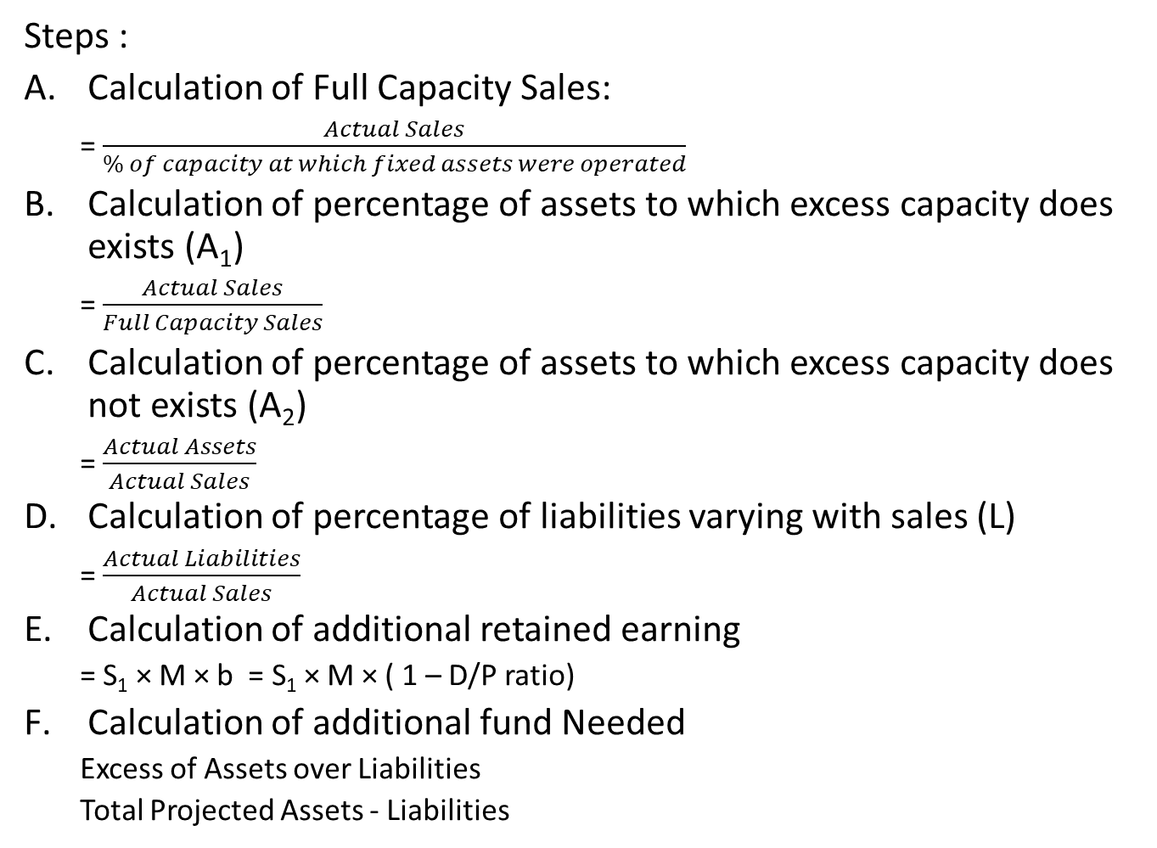
Excess capacity adjustment Method
Steps :
Calculation of Full Capacity Sales:
= $\frac{Actual Sales}{\% of capacity at which fixed assets were operated}$
Calculation of percentage of assets to which excess capacity does exists (A₁)
= $\frac{Actual Sales}{Full Capacity Sales}$
Calculation of percentage of assets to which excess capacity does not exists (A₂)
= $\frac{Actual Assets}{Actual Sales}$
Calculation of percentage of liabilities varying with sales (L)
= $\frac{Actual Liabilities}{Actual Sales}$
Calculation of additional retained earning
= S₁ × M × b = S₁ × M × ( 1 – D/P ratio)
Calculation of additional fund Needed
Excess of Assets over Liabilities
Total Projected Assets - Liabilities

Slide 21
Example Problem
The balance sheet of the Asia Pacific Corporation is shown below:
The corporation’s actual sales in 2073 is Rs. 680,000 and it is expected Rs 900,000 in 2074. Its profit margin is 4% and dividend payout ratio is 60%. The fixed assets and inventory in 2073 were utilized to only 80% of the capacity. Calculate additional fund needed.
Equity and Liabilities | Amount | Assets | Amount
Share Capital | 120,000 | Fixed Assets | 163,200
Retained Earnings | 44,800 | Account Receivable | 13,600
Long term loan | 80,000 | Inventory | 68,000
Account Payable | 20,400 | Cash at bank | 27,200
Accruals | 6,800
Total | 272,000 | Total | 272,000

Slide 22
Analyzing the effects of changes in Ratios
Modifying Account Receivable
Modifying Inventories
(we will discuss on class)

